Slide 1


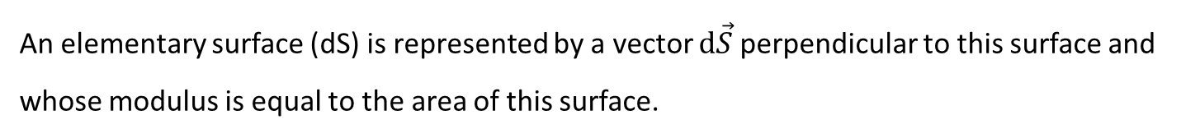





Chapter I: Part II
I. Electrostatic Field Flux- Gauss’s Law:
Representation of a surface:
An elementary surface (dS) is represented by a vector $d\vec{S}$perpendicular to this surface and whose modulus is equal to the area of this surface.
$$\vec{dS}$$
$$d\vec{S}=dS\vec{u}$$
$$\vec{u}$$
With$\left|\vec{u}\right|=1$
$$(dS)$$
For a closed surface, The vector $\vec{dS}$ is oriented outward..

Slide 2
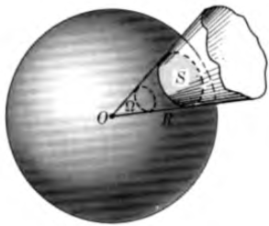
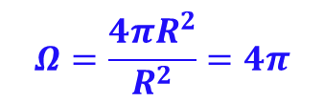
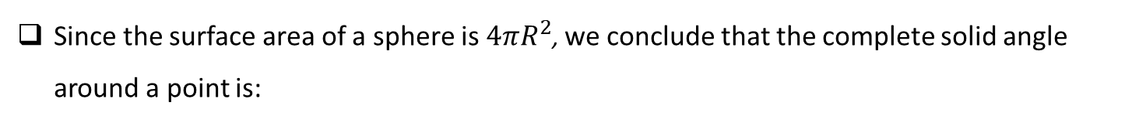

Solid Angles
A solid angle is the space included inside a conical (or pyramidal) surface.
Its value, expressed in steradians (sr), is obtained by drawing, with arbitrary radius R and center at the vertex O , a spherical surface and applying the relation:
$$Ω=\frac{S}{R^{2}}$$
S : area of the spherical cap intercepted by the solid angle.
Since the surface area of a sphere is $4πR^{2}$, we conclude that the complete solid angle around a point is:
$$Ω=\frac{4πR^{2}}{R^{2}}=4π$$

Slide 3










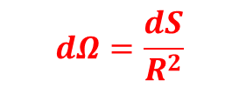


When the solid angle is small, Then:
$$\vec{dS}$$
$$dΩ=\frac{dS}{R^{2}}$$
P
$$dΩ$$
$$R$$
$$O$$
In some cases the surface dSis not perpendicular to $\vec{OP}$, it makes an angle $θ$with OP.
Then it is necessary to project dS on a plane perpendicular to OP, which gives us the area:
$$dS′ = dS cos⁡θ$$
$$\vec{dS}$$
$$θ$$
$$\vec{dS′}$$
$$dΩ=\frac{dS cos⁡θ}{R^{2}}$$
P
Thus:
$$dΩ$$
$$R$$
$$O$$

Slide 4
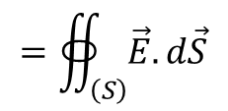


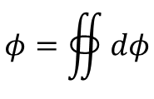






Gauss’s law:
Flux of the Electrostatic Field:
Let a closed surface (S) inside which there is a charge q.
$$d\vec{S}$$
$$\vec{E}$$
$$\vec{u}$$
$$r$$
$$q_{i}$$
$$\left(dS\right)$$
$$\left(S\right)$$
The flux of the electrostatic field ($\vec{E}$ ) through the surface dS is:
$$dφ=\vec{E}.d\vec{S}$$
The total flow of $\vec{E}$ across the surface S is therefore:
$$φ=∯{dφ}$$
$$=∯_{\left(S\right)}^{ }{\vec{E}.d\vec{S}}$$

Slide 5
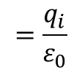


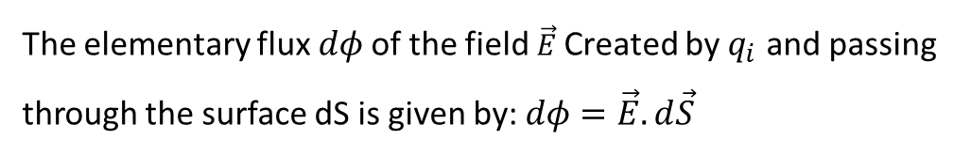
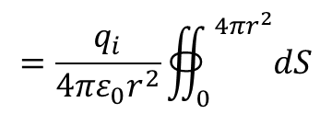


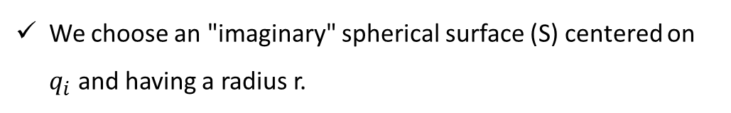
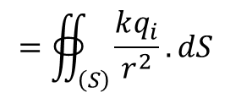


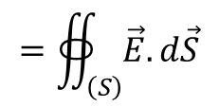

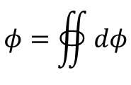

Gauss's theorem:
A simple example allows us to find Gauss's theorem:
$$d\vec{S}$$
Let a positive charge $q_{i}.$
$$\vec{E}$$
We choose an "imaginary" spherical surface (S) centered on $q_{i}$ and having a radius r.
$$\left(dS\right)$$
The elementary flux $dφ$of the field $\vec{E}$Created by $q_{i}$ and passing through the surface dSisgiven by: $dφ=\vec{E}.d\vec{S}$
$$r$$
$$q_{i}$$
+
$$\left(\vec{E}∕∕ \vec{dS}\right)$$
$$\left(S\right)$$
The total flow $φ$of $\vec{E }$across the surface (𝑆) istherefore:
$$φ=∯{dφ}$$
$$=∯_{\left(S\right)}^{ }{\vec{E}.d\vec{S}}$$
$$=∯_{\left(S\right)}^{ }{\frac{kq_{i}}{r^{2}}.dS}$$
$$=\frac{q_{i}}{4πε_{0}r^{2}}∯_{0}^{ 4πr^{2}}{dS}$$
$$=\frac{q_{i}}{ε_{0}}$$
Consider now a charge q inside an arbitrary closed surface S

Slide 6
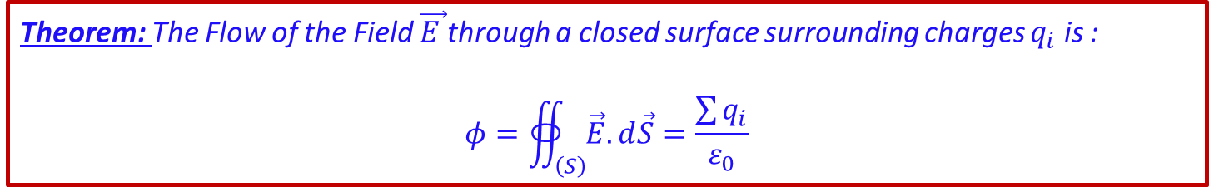
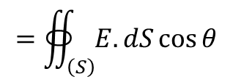
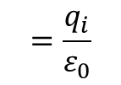

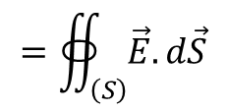
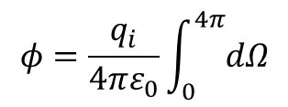
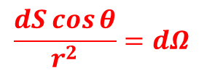
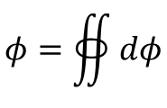
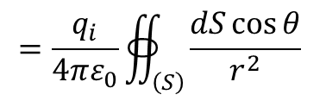

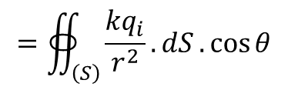
Consider now a charge q inside an arbitrary closed surface S
$$d\vec{S}$$
We have : $dφ=\vec{E}.d\vec{S}$
$$\vec{E}$$
$$r$$
$$φ=∯{dφ}$$
$$=∯_{\left(S\right)}^{ }{\vec{E}.d\vec{S}}$$
$$=∯_{\left(S\right)}^{ }{E.dS\cos{θ}}$$
$$q_{i}$$
$$\left(dS\right)$$
$$=∯_{\left(S\right)}^{ }{\frac{kq_{i}}{r^{2}}.dS}.\cos{θ}$$
$$=\frac{q_{i}}{4πε_{0}}∯_{\left(S\right)}^{ }{\frac{dS\cos{θ}}{r^{2}} }$$
$$\left(S\right)$$
$$\frac{dS\cos{θ}}{r^{2}}=dΩ$$
: solid angle subtended by the surface element dS as viewed from the charge q
Since the total solid angle around any point is 4π steradians. Then:
$$φ=\frac{q_{i}}{4πε_{0}}\int_{0}^{4π}{dΩ}$$
$$=\frac{q_{i}}{ε_{0}}$$
Theorem: The Flow of the Field $\vec{E }$through a closed surface surrounding charges$q_{i}$ is :
$$φ=∯_{\left(S\right)}^{ }{\vec{E}.d\vec{S}}=\frac{\sum{q_{i}}}{ε_{0}}$$

Slide 7
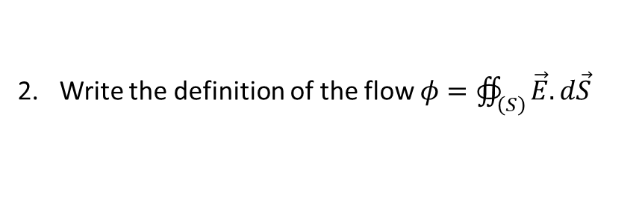
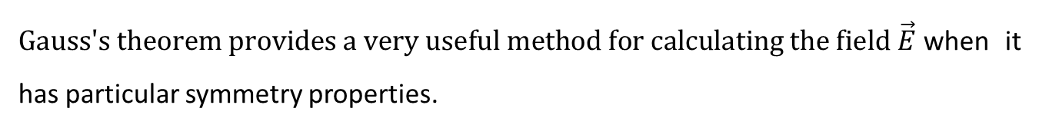

Method of applying Gauss's theorem:
Gauss's theorem provides a very useful method for calculating the field $\vec{E}$when it has particular symmetry properties.
Find a closed surface passing through the point "M" where we want to calculate the field.
The chosen surface must be composed of parts where:
Let the field be null
Let the field be constant in modulus and equal to$E_{M}$ and parallel to$d\vec{S}$
Let the field be perpendicular to $d\vec{S}$
Write the definition of the flow $φ=∯_{\left(S\right)}^{ }{\vec{E}.d\vec{S}}$
Apply Gaussian's theorem after counting the algebraic charge inside the surface.

Slide 8








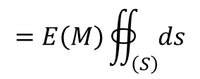

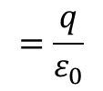
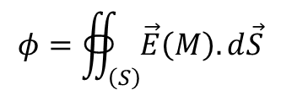



Applications
Example 1:
Determine the expression of the field created by a punctual charge q at a point M in space at a distance r from the charge q.
The problem has spherical symmetry,
$$d\vec{S}$$
$$d\vec{E}$$
$$r$$
$$M$$
The field is radial $\vec{E}\left(M\right)=E\left(M\right){\vec{u}}_{r}$,
$$q$$
$$\left(dS\right)$$
The surface of Gauss (S) to chosed is a sphere with center O and radius r.
$$O$$
At each point of (S) the field is:
Perpendicular to (S)
Constant in modulus
$$φ=∯_{\left(S\right)}^{ }{\vec{E}\left(M\right).d\vec{S}}$$
$$=E\left(M\right)∯_{\left(S\right)}^{ }{ds}$$
$$=\frac{\sum{q_{i}}}{ε_{0}}$$
$$=\frac{q}{ε_{0}}$$
$$=E\left(M\right).S$$
$$=E\left(M\right).4πr^{2}$$
$$⟹E\left(M\right)=\frac{q}{4πε_{0}r^{2}}$$

Slide 9

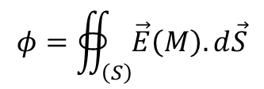

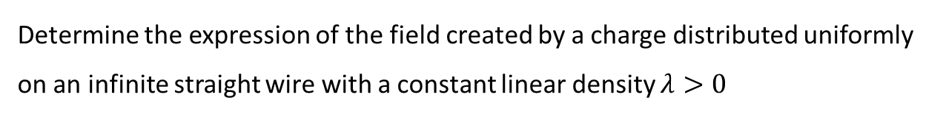



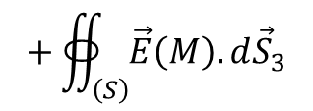



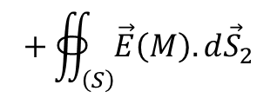

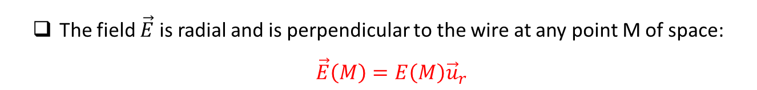
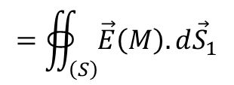
Example 2:
Determine the expression of the field created by a charge distributed uniformly on an infinite straight wire with a constant linear density $λ>0$
The field$\vec{E}$is radial and is perpendicular to the wire at any point M of space: $\vec{E}\left(M\right)=E\left(M\right){\vec{u}}_{r}$
$$d{\vec{S}}_{2}$$
The problem has cylindrical symmetry
The chosen Gaussian surface (S) is a closed cylinder of radius r and length L.
$$d\vec{E}$$
$$d{\vec{S}}_{1}$$
The surface (S) consists of the 3 surfaces: $S_{1}, S_{2}, S_{3}$
$S_{1}$: represent by $d{\vec{S}}_{1}$with $d\vec{E}$//$d{\vec{S}}_{1}$
$$d{\vec{S}}_{3}$$
$S_{2}$: represent by $d{\vec{S}}_{2}$ with $d\vec{E}⊥d{\vec{S}}_{2}$
$S_{3}$: represent by $d{\vec{S}}_{3}$ with $d\vec{E}⊥d{\vec{S}}_{3}$
$$0$$
$$0$$
$$φ=∯_{\left(S\right)}^{ }{\vec{E}\left(M\right).d\vec{S}}$$
$$=∯_{\left(S\right)}^{ }{\vec{E}\left(M\right).d{\vec{S}}_{1}}$$
$$+∯_{\left(S\right)}^{ }{\vec{E}\left(M\right).d{\vec{S}}_{2}}$$
$$+∯_{\left(S\right)}^{ }{\vec{E}\left(M\right).d{\vec{S}}_{3}}$$

Slide 10
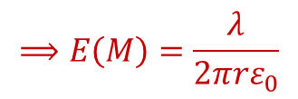
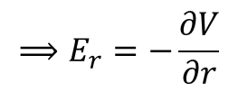

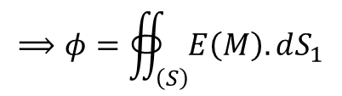


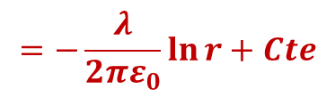
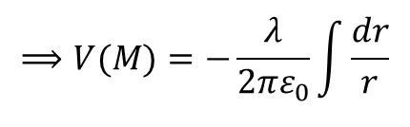
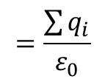


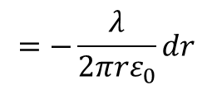
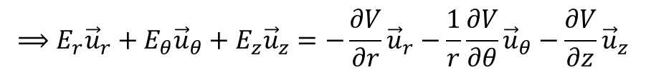




$$⟹φ=∯_{\left(S\right)}^{ }{E\left(M\right).dS_{1}}$$
$$=E\left(M\right)∯_{\left(S\right)}^{ }{dS_{1}}$$
$$=\frac{\sum{q_{i}}}{ε_{0}}$$
$$=\frac{λL}{ε_{0}}$$
$$=E\left(M\right)2πrL$$
$$⟹E\left(M\right)=\frac{λ}{{2πrε}_{0}}$$
From this, we can deduce the expression of the potential from the relation:
$$0$$
$$0$$
$$0$$
$$0$$
$$⟹E_{r}{\vec{u}}_{r}+E_{θ}{\vec{u}}_{θ}+E_{z}{\vec{u}}_{z}=−\frac{∂V}{∂r}{\vec{u}}_{r}−\frac{1}{r}\frac{∂V}{∂θ}{\vec{u}}_{θ}−\frac{∂V}{∂z}{\vec{u}}_{z}$$
$$\vec{E}=−\vec{grad}V$$
$$⟹E_{r}=−\frac{∂V}{∂r}$$
$$=−\frac{λ}{{2πrε}_{0}}dr$$
$$⟹dV=−Edr$$
$$⟹V(M)=−\frac{λ}{{2πε}_{0}}\int{\frac{dr}{r}}$$
$$=−\frac{λ}{{2πε}_{0}}\ln{r}+Cte$$

Slide 11

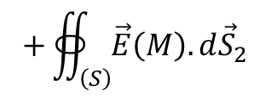

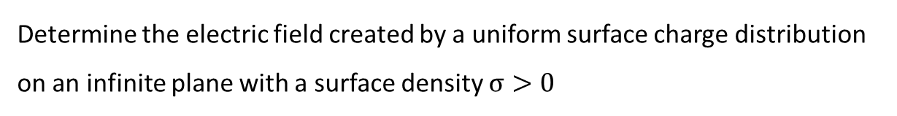

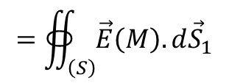
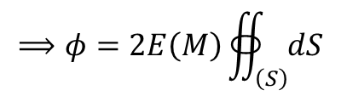
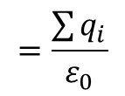










Example 3:
Determine the electric field created by a uniform surface charge distribution on an infinite plane with a surface density $σ>0$
$${\vec{E}}_{2}$$
$${\vec{E}}_{1}$$
$\vec{E}$ is perpendicular to the plane
$\vec{E}$is uniform on both sides of the plane but the direction changes: ${\vec{E}}_{1}=−{\vec{E}}_{2}$
$$d{\vec{S}}_{2}$$
$$d{\vec{S}}_{1}$$
We take as the Gaussian surface a cylinder of height h and base area S, symmetrical with respect to the plane.
$$d{\vec{S}}_{3}$$
The surface (S) consists of the 3 surfacesrepresented by ${\vec{dS}}_{1}, {\vec{dS}}_{2}, {\vec{dS}}_{3}$
$$0$$
$$φ=∯_{\left(S\right)}^{ }{\vec{E}\left(M\right).d\vec{S}}$$
$$=∯_{\left(S\right)}^{ }{\vec{E}\left(M\right).d{\vec{S}}_{1}}$$
$$+∯_{\left(S\right)}^{ }{\vec{E}\left(M\right).d{\vec{S}}_{2}}$$
$$+∯_{\left(S\right)}^{ }{\vec{E}\left(M\right).d{\vec{S}}_{3}}$$
$$=\frac{\sum{q_{i}}}{ε_{0}}$$
$$⟹φ=2E\left(M\right)∯_{\left(S\right)}^{ }{dS}$$
$$=\frac{σS}{ε_{0}}$$
$$⟹E\left(M\right)=\frac{σ}{2ε_{0}}$$
$$=2E\left(M\right).S$$

Slide 12













Example 4:
Let be a solid ball with center O and radius R uniformly charged by volume (with charge density ρ). Calculate the electrostatic field created by this ball inside, on the surface, and outside the ball.
We take, as a Gaussian surface, a sphere with center O and radius r.
$$φ=∯_{\left(S\right)}^{ }{\vec{E}\left(M\right).d\vec{S}}=\frac{\sum{q_{i}}}{ε_{0}}$$
$$⟹E\left(M\right).4πr^{2}=\frac{ρV_{i}}{ε_{0}}$$
$$r$$
$$R$$
Inside the ball:
$$O$$
$$\sum{q_{i}}=ρ\frac{4}{3}πr^{3}$$
$$⟹E\left(M\right)=\frac{ρr}{{3ε}_{0}}$$
$$r$$
$r<R:$
On the surface and outside of the ball:
$$\sum{q_{i}}=ρ\frac{4}{3}πR^{3}$$
$$⟹E\left(M\right)=\frac{ρR^{3}}{{3ε}_{0}r^{2}}$$
$r≥R:$

