Slide 1

University of Djilali BOUNAAMA-Khemis Miliana
Faculty of Matter Science and science computer
Department of Mathematics
Course of Physics 2: Electricity
Level: 1st year Bachelor's degree Mathematics
Academic year: 2023/2024
Prepared by: Dr. Rachid CHADOULI

Slide 2
Program of Physics 2 matter
Chapter I: Electrostatics:
1- Charge and electrostatic field. 2- Electrostatic Potential. 3- Electric Dipole. 4- Electric Field Flow. 5- Gauss's theorem. 6- Conductors in Electrostatic Equilibrium.
7- Electrostatic Pressure. 8- Conductor and capacitor capacity.
Electrostatics is the study of electricity in a static state.
Chapter II: Electrokinetics
1- Electrical conductor. 2- Ohm's Law. 3- Joule's Law. 4- Electrical Circuits.
5- Application of Ohm's Law to electrical networks. 6- Kirchhoff's Law.
Chapter III: Electromagnetism :
1- Definition of a magnetic field. 2- Lorentz force. 3- Laplace’s Law.
4- Faraday's law. 5- Biot and Savart's law. 6- Magnetic dipole.

Slide 3
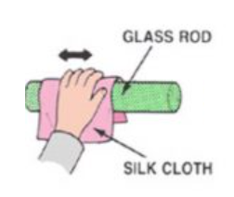
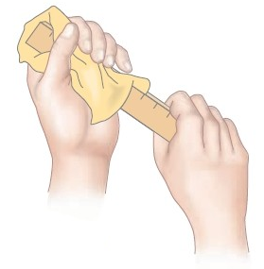
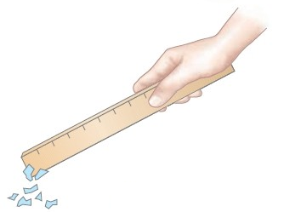
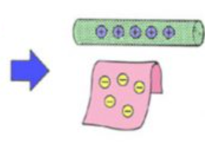
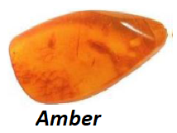
Chapter I: Electrostatics
I. Generality:
I.1. Electrostatic phenomena: are natural phenomena that man encounters in his daily life, such as the attraction of small paper objects by rubbed bodies (glass rod, amber stick, etc..)
When the glass rod is rubbed with silk cloth, it loses electrons and gets positively charged, while the silk gains those electrons and gets negatively charged.
The word "electricity" comes from the Greek "eleckron" which means « amber » (العنبر)

Slide 4







I.2. Electrification process:
Electrification can be achieved either by friction or by contact,
A
B
a- Electrisation par frottement:
Glass rubbed with silk(الحرير)
Amber rubbed with fur(الفرو)
Cork Ballالفلين
B
B
A
A
Glass + Silk: The electrons pass from the glass to the silk, so the glass is positively charged and the silk negatively charged .
$$⟹$$
$$Positive Electricity$$
Amber + Fur: The electrons pass from the fur to the amber, so the fur is positively charged and the amber negatively.
$$⟹$$
$$Negative Electricity$$

Slide 5
a- Electrification by Contact:
A
A
B
A
Repulsion
Attraction
Two charges of the same nature (same sign) repel each other and two charges of different nature attract each other.

Slide 6
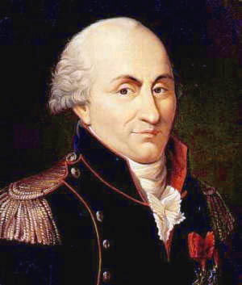
II. Electric charge:
II.1. Definition:
Electric charge is a characteristic possessed by certain particles between which an electrical interaction takes place.
Some particles have a charge and are said to be "charged" while others do not and are said to be "neutral".
Unit of the electric Charge
The unit of electric charge is the Coulomb with symbol "C"
(in homage to the French physicist Charles-Augustin Coulomb)
Elementary electric charge :
Denoted "e" and has the following value: e = 1.6021766208 .10⁻¹⁹ C ~ 1.60 .10⁻¹⁹ C

Slide 7
II.2. Quantification of the electric charge:
The accessible elementary charge is that of the electron, which is negative by convention.
All other charges are integer multiples of the elementary charge.
The charge in this case is called « Quantify»:
Q=ne
Particle | Charge | Mass
Electron | -e=-1,6.10⁻¹⁹ C | 9,109.10⁻³¹ kg
Proton | +e= 1,6. 10⁻¹⁹ C | 1,672. 10⁻²⁷ kg
Neutron | 0 | 1,67410⁻²⁷ kg
Conservation of the Electric Charge :
The electric charge of an isolated system, i.e. the algebraic sum of the positive and negative charges present at a time "t", always remains constant,
Isolated system$⟹$No exchange ofchargeswith the outside

Slide 8

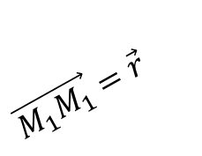


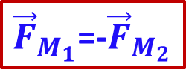





III. Force and Electrostatic Field:
Punctual Charge:
is an electric charge located at a dimensionless point.
III.1. Electric Force – Coulomb's Law:
The electric force created between two electric charges q₁ and q₂, separated by a distance r, is given by:
$${\vec{F}}_{M_{1}}=\frac{kq_{1}q_{2}}{r^{2}}\vec{u}$$
q₂
+
$$\vec{M_{1}M_{1}}=\vec{r}$$
$$M_{2}$$
$$k=\frac{1}{4πε_{0}}=8,988.{10}^{9}Nm^{2}/C^{2}≅9.{10}^{9}Nm^{2}/C^{2}$$
q₁
$$\vec{u}$$
-
$$M_{2}$$
+
${\vec{F}}_{M_{1}}$=-${\vec{F}}_{M_{2}}$
$$M_{1}$$
$$\vec{u}$$
+
$$M_{1}$$

Slide 9

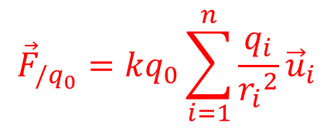









Principe of superposition:
The force applied to thecharge q₀:
q₁
$${\vec{u}}_{1}$$
$$r_{1}$$
q₂
$${\vec{u}}_{2}$$
$$r_{2}$$
$${\vec{F}}_{/q_{0}}=\frac{kq_{1}q_{0}}{{r_{1}}^{2}}{\vec{u}}_{1}+\frac{kq_{2}q_{0}}{{r_{2}}^{2}}{\vec{u}}_{2}+…+\frac{kq_{n}q_{0}}{{r_{n}}^{2}}{\vec{u}}_{n}$$
$${\vec{u}}_{3}$$
$$r_{3}$$
q₀
q₃
$$r_{n}$$
$${\vec{F}}_{/q_{0}}=kq_{0}\sum_{i=1}^{n}{\frac{q_{i}}{{r_{i}}^{2}}{\vec{u}}_{i}}$$
$${\vec{u}}_{n}$$
$$q_{n}$$

Slide 10

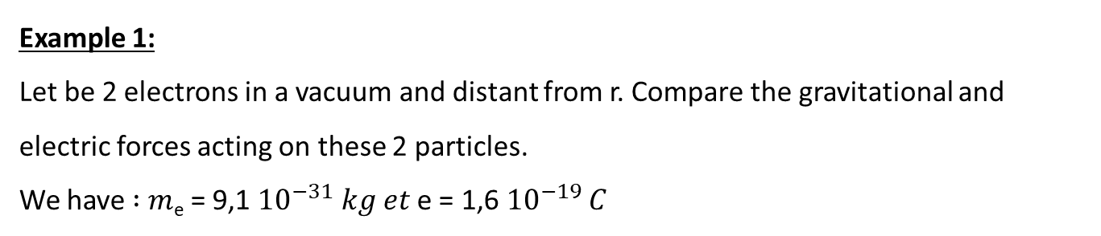

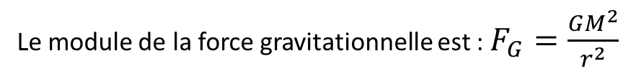

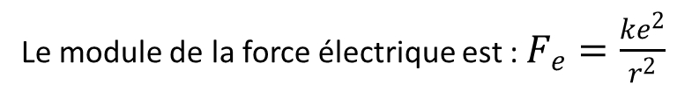

Example 1:
Let be 2 electrons in a vacuum and distant from r. Compare the gravitational and electric forces acting on these 2 particles.
We have ∶ 𝑚_{e} = 9,1 ${10}^{−31}$ 𝑘𝑔 𝑒𝑡 e = 1,6 ${10}^{−19}$ 𝐶
$$q_{1}=e^{−}$$
$$r$$
$$q_{e}=e^{−}$$
Answer:
-
-
The modulus of the electric force is: $F_{e}=\frac{ke^{2}}{r^{2}}$
The modulus of the gravitational force is: $F_{G}=\frac{GM^{2}}{r^{2}}$
$$\frac{F_{e}}{F_{G}}=\frac{ke^{2}}{Gm^{2}}=\frac{9. {10}^{9} {\left(1,6 {10}^{−19}\right)}^{2}}{9 .{10}^{−31} {\left(9,1 {10}^{−31}\right)}^{2}}=4,17 .{10}^{42}$$
$$⟹So the electric force is very important compared to the gravitational force.$$

Slide 11
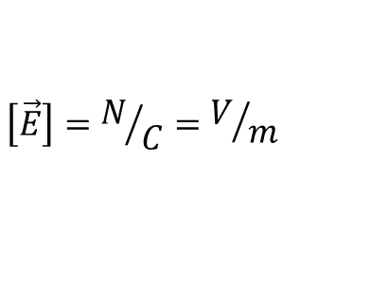






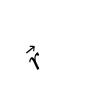

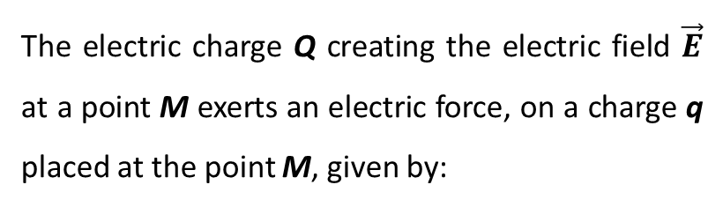


III.2. Electrostatic field:
The electrostatic field created by the charge Q at any point M in space at a distance r from the charge is given by:
$${\vec{E}}_{Q}\left(M\right)=\frac{kQ}{r^{2}}\vec{u} ,$$
$$\left[\vec{E}\right]=N/C=V/m$$
q
$$\vec{F}$$
+
$$\vec{r}$$
$$M$$
Relationship between force and electric field:
The electric charge Q creating the electric field $\vec{E}$ at a point M exerts an electric force, on a charge q placed at the point M, given by:
$$\vec{u}$$
q
Q
+
-
$$M$$
P
$$\vec{F}$$
Q
$$\vec{u}$$
$$\vec{F}=\frac{kQq}{r^{2}}\vec{u}$$
$$=q\vec{E}$$
-
The direction of the electric field depends on the sign of the charge Q:
It is outgoing if the charge is positive.
It goes in if the charge is negative.

Slide 12




-
$$\vec{F}=\vec{0}$$
+
$$\vec{F}=\vec{0}$$
$$\vec{F}=+\left|q\right|\vec{E}$$
-
+
$$\vec{F}=−\left|q\right|\vec{E}$$
+

Slide 13


$$\vec{F}=−\left|q\right|\vec{E}$$
$$\vec{F}=+\left|q\right|\vec{E}$$
-
+
-

Slide 14





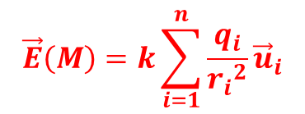




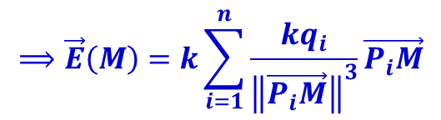



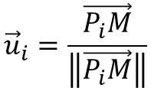
A field created by a set ofcharges - Principe of superposition:
$$q_{1}\left(P_{1}\right)$$
$${\vec{u}}_{1}$$
$$\vec{E}\left(M\right)={\vec{E}}_{1}(M)+{\vec{E}}_{2}(M)+…+{\vec{E}}_{n}(M)$$
$$r_{1}$$
$$q_{2}\left(P_{2}\right)$$
$${\vec{E}}_{n}$$
$${\vec{u}}_{2}$$
$$r_{2}$$
$$\vec{E}\left(M\right)=\frac{kq_{1}}{{r_{1}}^{2}}{\vec{u}}_{1}+\frac{kq_{2}}{{r_{2}}^{2}}{\vec{u}}_{2}+…+\frac{kq_{n}}{{r_{n}}^{2}}{\vec{u}}_{n}$$
M
$$q_{3}\left(P_{3}\right)$$
$${\vec{E}}_{3}$$
$$r_{3}$$
$${\vec{E}}_{2}$$
$${\vec{u}}_{3}$$
$${\vec{E}}_{1}$$
$$\vec{E}\left(M\right)=k\sum_{i=1}^{n}{\frac{q_{i}}{{r_{i}}^{2}}{\vec{u}}_{i}}$$
$$r_{n}$$
$${\vec{u}}_{n}$$
On the other hand, we have:
$$q_{n}\left(P_{n}\right)$$
$$r_{i}=\left\|\vec{P_{i}M}\right\|$$
$$⟹\vec{E}\left(M\right)=k\sum_{i=1}^{n}{\frac{kq_{i}}{{\left\|\vec{P_{i}M}\right\|}^{3}}\vec{P_{i}M}}$$
$${\vec{u}}_{i}=\frac{\vec{P_{i}M}}{\left\|\vec{P_{i}M}\right\|}$$

Slide 15


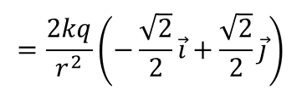
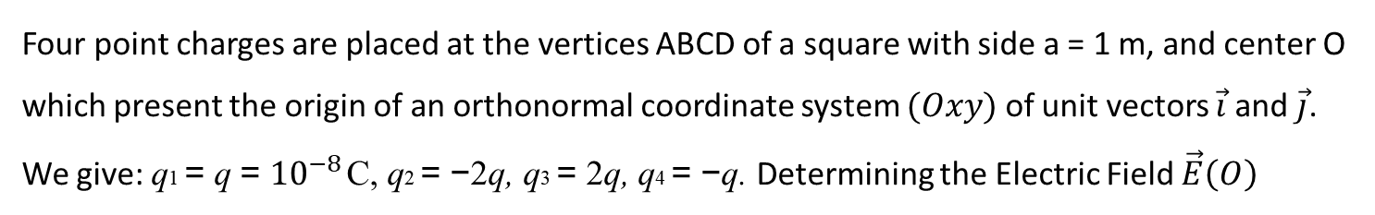





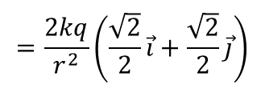



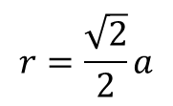


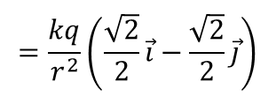




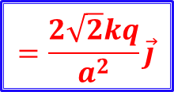








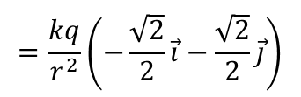
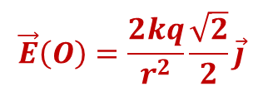

Example:
Four point charges are placed at the vertices ABCD of a square with side a = 1 m, and center O which present the origin of an orthonormal coordinate system $(Oxy)$ of unit vectors $\vec{i}$and $\vec{j}$.
Wegive: q1 = q = ${10}^{−8}$C, q2 = −2q, q3 = 2q, q4 = −q. Determining the Electric Field $\vec{E}\left(O\right)$
$$y$$
Solution:
The principle of superposition is applied:
$$A\left(q_{1}\right)$$
$$B\left(q_{2}\right)$$
$$\vec{E}\left(O\right)={\vec{E}}_{q_{1}}\left(O\right)+{\vec{E}}_{q_{2}}\left(O\right)+{\vec{E}}_{q_{3}}\left(O\right)+{\vec{E}}_{q_{4}}\left(O\right)$$
+
-
$$r$$
$$\vec{j}$$
$$r$$
$$=\frac{kq}{r^{2}}\left(\frac{\sqrt{2}}{2}\vec{i}−\frac{\sqrt{2}}{2}\vec{j}\right)$$
$${\vec{E}}_{q_{3}}$$
$${\vec{E}}_{q_{2}}$$
$${\vec{E}}_{q_{1}}\left(O\right)=E_{q_{1}}cos\frac{π}{4}\vec{i}−E_{q_{1}}sin\frac{π}{4}\vec{j}$$
$$O$$
$$x′$$
$$\vec{i}$$
$$x$$
$${\vec{E}}_{q_{4}}$$
$${\vec{E}}_{q_{2}}\left(O\right)=E_{q_{2}}cos\frac{π}{4}\vec{i}+E_{q_{2}}sin\frac{π}{4}\vec{j}$$
$$=\frac{2kq}{r^{2}}\left(\frac{\sqrt{2}}{2}\vec{i}+\frac{\sqrt{2}}{2}\vec{j}\right)$$
$${\vec{E}}_{q_{1}}$$
$$r$$
$$r$$
-
$$y′$$
+
$${\vec{E}}_{q_{3}}\left(O\right)=−E_{q_{3}}cos\frac{π}{4}\vec{i}+E_{q_{3}}sin\frac{π}{4}\vec{j}$$
$$=\frac{2kq}{r^{2}}\left(−\frac{\sqrt{2}}{2}\vec{i}+\frac{\sqrt{2}}{2}\vec{j}\right)$$
$$D\left(q_{4}\right)$$
$$C\left(q_{3}\right)$$
$$E_{q1}=E_{q3}=\frac{kq}{r^{2}}$$
$$=\frac{kq}{r^{2}}\left(−\frac{\sqrt{2}}{2}\vec{i}−\frac{\sqrt{2}}{2}\vec{j}\right)$$
$$r=\frac{\sqrt{2}}{2}a$$
$${\vec{E}}_{q_{3}}\left(O\right)=−E_{q_{4}}cos\frac{π}{4}\vec{i}−E_{q_{4}}sin\frac{π}{4}\vec{j}$$
$$E_{q2}=E_{q4}=\frac{k2q}{r^{2}}$$
$$\vec{E}\left(O\right)=\frac{2kq}{r^{2}}\frac{\sqrt{2}}{2}\vec{j}$$
$$=\frac{2\sqrt{2}kq}{a^{2}}\vec{j}$$

Slide 16

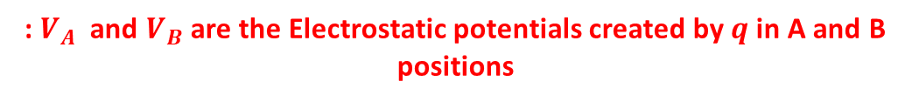

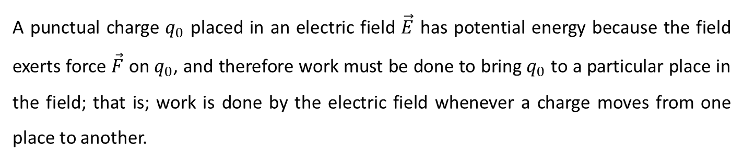
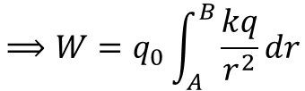
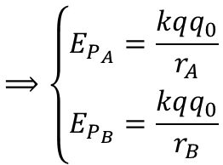

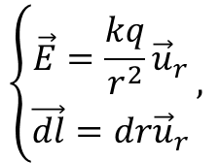
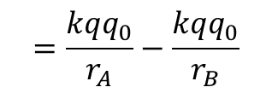
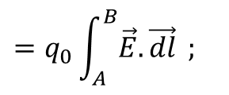

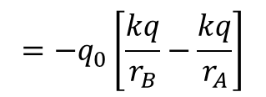
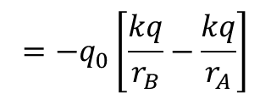
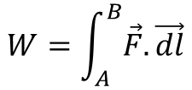


III.3. Electrostatic Potential:
A punctual charge $q_{0}$ placed in an electric field $\vec{E}$ has potential energy because the field exerts force $\vec{F}$ on $q_{0}$, and therefore work must be done to bring $q_{0}$ to a particular place in the field; that is; work is done by the electric field whenever a charge moves from one place to another.
We have:
$$=q_{0}\int_{A}^{B}{\vec{E}.\vec{dl}} ;$$
$$\left\{\begin{aligned}\vec{E}=\frac{kq}{r^{2}}{\vec{u}}_{r} \\ \vec{dl}=dr{\vec{u}}_{r}\end{aligned}\right.,$$
$$W=\int_{A}^{B}{\vec{F}.\vec{dl}}$$
$$⟹W=q_{0}\int_{A}^{B}{\frac{kq}{r^{2}}dr}$$
$$=−q_{0}\left[\frac{kq}{r_{B}}−\frac{kq}{r_{A}}\right]$$
The work W, not depending on the path followed, W is stored in the form of potential energy.
So we can write:
$$W=−∆E_{P}$$
$$=−q_{0}\left[\frac{kq}{r_{B}}−\frac{kq}{r_{A}}\right]$$
$$=\frac{kqq_{0}}{r_{A}}−\frac{kqq_{0}}{r_{B}}$$
$$=E_{P_{A}}−E_{P_{B}}$$
$$⟹\left\{\begin{aligned}E_{P_{A}}=\frac{kqq_{0}}{r_{A}} \\ E_{P_{B}}=\frac{kqq_{0}}{r_{B}}\end{aligned}\right.$$
$$=q_{0}V_{A}$$
: $V_{A}$ and $V_{B}$are the Electrostaticpotentialscreated by $q$ in A and B positions
$$=q_{0}V_{B}$$
In general:
$$V\left(r\right)=\frac{kq}{r}+Cts$$
$$\left[V\right]=Volt=V$$
$(Cts$is the Integration Constant; For a punctual charge : $Cts=0)$

Slide 17

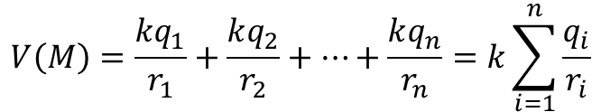

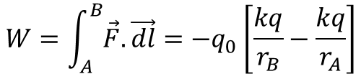

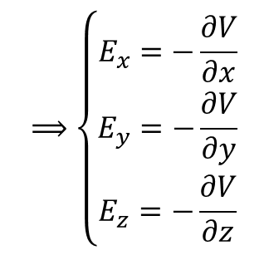
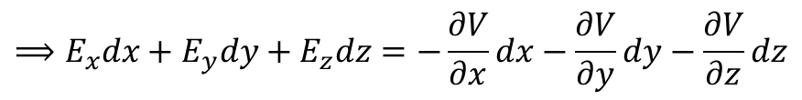
Principe of superposition:
The total electrostatic potential created by n charges at point M is equal to the sum of the partial electrostatic potentials created by these charges:
$$V\left(M\right)=\frac{kq_{1}}{r_{1}}+\frac{kq_{2}}{r_{2}}+…+\frac{kq_{n}}{r_{n}}=k\sum_{i=1}^{n}{\frac{q_{i}}{r_{i}}}$$
Relationship between electrostatic field and potential:
$$W=\int_{A}^{B}{\vec{F}.\vec{dl}}=−q_{0}\left[\frac{kq}{r_{B}}−\frac{kq}{r_{A}}\right]$$
$$⟹\vec{E}.\vec{dl}=−dV$$
$$=−q_{0}\left(V_{B}−V_{A}\right)$$
$$⟹\left\{\begin{aligned}E_{x}=−\frac{∂V}{∂x} \\ E_{y}=−\frac{∂V}{∂y} \\ E_{z}=−\frac{∂V}{∂z}\end{aligned}\right.$$
$$⟹E_{x}dx+E_{y}dy+E_{z}dz=−\frac{∂V}{∂x}dx−\frac{∂V}{∂y}dy−\frac{∂V}{∂z}dz$$
We obtain:
$$\vec{E}=−\vec{grad}V$$
( Analogy with the law of universal gravitation: $\vec{F}=−\vec{grad}E_{P}$)

Slide 18
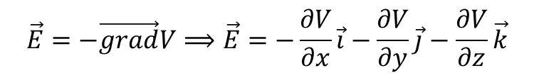

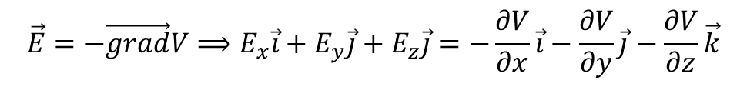






In Cartesian coordinates:
$$\vec{E}=−\vec{grad}V⟹E_{x}\vec{i}+E_{y}\vec{j}+E_{z}\vec{j}=−\frac{∂V}{∂x}\vec{i}−\frac{∂V}{∂y}\vec{j}−\frac{∂V}{∂z}\vec{k}$$
In Cylindrical coordinates:
$$\vec{E}=−\vec{grad}V⟹E_{r}\vec{u_{r}}+E_{θ}{\vec{u}}_{θ}+E_{z}\vec{j}=−\frac{∂V}{∂r}{\vec{u}}_{r}−\frac{1}{r}\frac{∂V}{∂θ}{\vec{u}}_{θ}−\frac{∂V}{∂z}\vec{k}$$
In Spherical coordinates:
$$\vec{E}=−\vec{grad}V⟹E_{r}\vec{u_{r}}+E_{θ}{\vec{u}}_{θ}+E_{φ}\vec{j}=−\frac{∂V}{∂r}{\vec{u}}_{r}−\frac{1}{r}\frac{∂V}{∂θ}{\vec{u}}_{θ}−\frac{1}{rsinθ}\frac{∂V}{∂φ}{\vec{u}}_{φ}$$
Example:
Let : $V\left(x,y,z\right)=3x^{2}y+z^{2}$
Calculate the modulus of$\vec{E}$at point $A\left(1,2,−1\right).$
Solution:
$$\vec{E}=−\vec{grad}V⟹\vec{E}=−\frac{∂V}{∂x}\vec{i}−\frac{∂V}{∂y}\vec{j}−\frac{∂V}{∂z}\vec{k}$$
$$−2z\vec{k}$$
$$=−6xy\vec{i}$$
$$−3x^{2}\vec{j}$$
$$\vec{E}\left(A\right)=−12\vec{i}−3\vec{j}+2\vec{k}$$
$$⟹\left\|\vec{E}\right\|=\sqrt{{12}^{2}+3^{2}+2^{2}}=12,53V/m$$

Slide 19










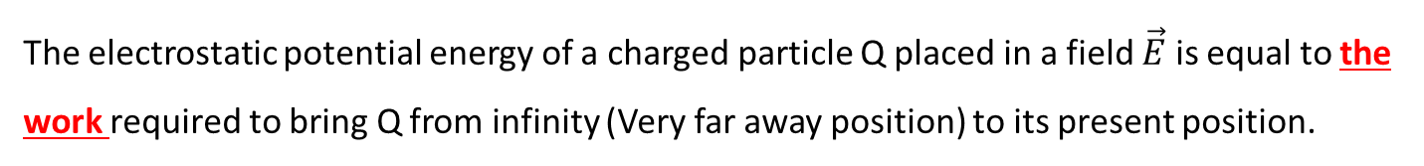




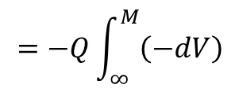



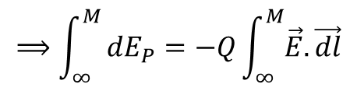
III.4. Potential (Internal ) Energy of a punctual charges distribution:
Definition:
The electrostatic potential energy of a charged particle Q placed in a field$\vec{E}$is equal to the work required to bring Q from infinity (Very far away position) to its present position.
For a charge particle Q placed in a field $\vec{E}$ :
$$⟹\int_{∞}^{M}{dE_{P}=−Q\int_{∞}^{M}{\vec{E}.\vec{dl}}}$$
$$=−Q\int_{∞}^{M}{\left(−dV\right)}$$
$$dE_{P}=−dW=−\vec{F}.\vec{dl}$$
$$=−Q\vec{E}.\vec{dl}$$
$$0$$
$$0$$
$$⟹E_{P}\left(M\right)−E_{P}\left(∞\right)=Q\left(V_{M}−V_{∞}\right)$$
$$⟹E_{P}\left(M\right)=U(M)=QV_{M}$$
Internal energy of a system of two punctual charges placed at a distance d:
Let be the charge $q_{1}$placed in point$P_{1}.$
We then bring a charge $q_{2}$ from infinity to $P_{2}.$
$⟹$ The necessary work is:
$$q_{1}$$
$$q_{2}$$
$$q_{2}\left(∞\right)$$
$$W=q_{2}V_{1}\left(M\right)=q_{1}V_{2}\left(M\right)$$
$$P_{1}$$
$$d$$
$$P_{2}$$
$$⟹U=\frac{kq_{1}q_{2}}{d}=\frac{q_{1}q_{2}}{4πε_{0}d}$$

Slide 20

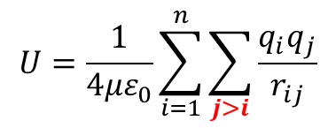


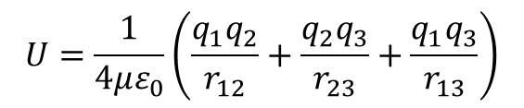






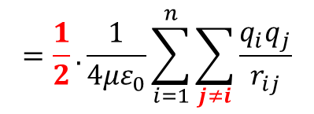
Internal Energy of a System of Three Punctual Charges:
$$q_{1}$$
$$r_{12}$$
$$q_{2}$$
$$U=\frac{1}{4με_{0}}\left(\frac{q_{1}q_{2}}{r_{12}}+\frac{q_{2}q_{3}}{r_{23}}+\frac{q_{1}q_{3}}{r_{13}}\right)$$
$$P_{1}$$
$$P_{2}$$
$$r_{13}$$
$$q_{3}$$
$$r_{23}$$
$$P_{3}$$
Internal Energy of a System of « n » Punctual Charges :
$$U=\frac{1}{4με_{0}}\sum_{i=1}^{n}{\sum_{j>i}{\frac{q_{i}q_{j}}{r_{ij}}}}$$
$$=\frac{1}{2}.\frac{1}{4με_{0}}\sum_{i=1}^{n}{\sum_{j≠i}{\frac{q_{i}q_{j}}{r_{ij}}}}$$

Slide 21

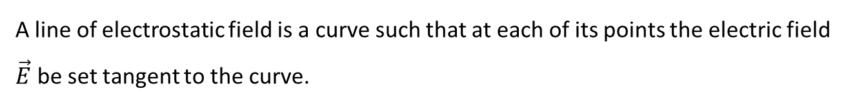


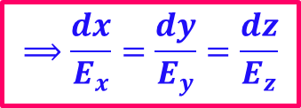








III.5. Topography of the Vector Space:
1- Electrostatic Field Lines:
A line of electrostatic field is a curve such that at each of its points the electric field$\vec{E}$be set tangent to the curve.
$$\vec{E}$$
$$\vec{E}$$
Equation of the Electrostatic Field Line:
For an elementary displacement $dl$we have:
$$\left(C\right)$$
$$\vec{E}$$
$$\vec{E}∕∕\vec{dl}$$
$$⟹\vec{E}∧\vec{dl}=\vec{0}$$
In Cartesian coordinates:
$$\vec{dl}=dx\vec{i}+dy\vec{j}+dz\vec{k}$$
$$\vec{E}∧\vec{dl}=\vec{0}$$
$$⟹\left(E_{y}dz−E_{z}dy\right)\vec{i}−\left(E_{x}dz−E_{z}dx\right)\vec{j}+\left(E_{x}dy−E_{y}dx\right)\vec{k}=\vec{0}$$
$$⟹\left\{\begin{aligned}\frac{dy}{E_{y}}=\frac{dx}{E_{x}} \\ \frac{dz}{E_{z}}=\frac{dx}{E_{x}} \\ \frac{dz}{E_{z}}=\frac{dy}{E_{y}}\end{aligned}\right.$$
$$⟹\left\{\begin{aligned}E_{x}dy−E_{y}dx=0 \\ E_{x}dz−E_{z}dx=0 \\ E_{y}dz−E_{z}dy=0\end{aligned}\right.$$
$$⟹\frac{dx}{E_{x}}=\frac{dy}{E_{y}}=\frac{dz}{E_{z}}$$

Slide 22




Properties:
The lines of the field always start from the positive charge to the negative charge
The electrostatic field lines never intersect.
The number of the electrostatic field lines is proportional to the intensity of the field.

Slide 23




Equipotential:
A surface is said to be equipotential if the potential V at any point on that surface is constant.
Properties:
The potential decreases along a field lines :
$dV=−\vec{E}.\vec{dl}$
Electric field lines are perpendicular to
the equipotential surfaces:
For a displacement $\vec{dl}$on an equipotential surface, we have:
$$V=cte ⟹dV=0 ⟹−\vec{E}.\vec{dl}=0⟹\vec{E}⊥\vec{dl}$$

Slide 24


The equipotential surfaces tighten when we move from a region of space where the field is not very intense to a region where the field is more intense.
The work of the electric forces applied to a charge moving on an equipotential surface is zero.
$$dW=−\vec{F}.\vec{dl}=−q\vec{E}.\vec{dl}=−qdV=0 (V=cts)$$

Slide 25







III.6. Electrostatic Dipole:
Consisting of the arrangement of two equal and opposite charges $\left(+q,−q\right)$ separated by a distance d=2a .
$$\vec{i}$$
III.6.1. Electrostatic Dipole Moment:
-
$$d=2a$$
+
The electricdipole moment, denoted$\vec{P}$, isgiven by:
$$\vec{P}$$
$$\vec{P}=q\vec{d}=2q\vec{a}=2qa\vec{i}$$
$\left[\vec{P}\right]=C. m$ Ou Debye (D)
$$1 D=3,336.{10}^{−30}C.m$$
$\vec{d} :$represents the displacement from the negative charge to the positive charge

Slide 26




































$$\vec{E}\left(M\right)$$
The electric field is given by:
$${\vec{E}}_{θ}$$
$${\vec{E}}_{r}$$
$$\vec{E}\left(M\right)=−\vec{grad}V$$
$$M$$
In polar coordinates by:
$$r_{2}$$
$$r$$
$$\vec{E}\left(M\right)=E_{r}{\vec{u}}_{r}+E_{θ}{\vec{u}}_{θ}$$
$$=−\frac{∂V}{∂r}{\vec{u}}_{r}−\frac{1}{r}\frac{∂V}{∂θ}{\vec{u}}_{θ}$$
$$r_{1}$$
$${\vec{u}}_{θ}$$
$${\vec{u}}_{r}$$
$$θ$$
$$V=k\frac{Pcosθ}{r^{2}}$$
$$⟹\vec{E}\left(M\right)=\frac{2kP}{r^{3}}\cos{θ} {\vec{u}}_{r}+\frac{kP}{r^{3}}\sin{θ}{\vec{u}}_{θ}$$
-
+
$$−q$$
$$a$$
$$a$$
$$+q$$
$$M$$
$$\vec{E}\left(M\right)=\frac{2kP}{r^{3}}{\vec{u}}_{r}$$
$$\vec{E}\left(M\right)$$
$θ=0 :$
$$\vec{E}\left(M\right)=\frac{kP}{r^{3}}{\vec{u}}_{θ}$$
$$r_{2}$$
$$r$$
$θ=\frac{π}{2}:$
$$r_{1}$$
$$r$$
$${\vec{u}}_{r}$$
$$\frac{π}{2}$$
$${\vec{u}}_{θ}$$
+
$${\vec{u}}_{θ}$$
-
$$a$$
$${\vec{u}}_{r}$$
$$a$$
$$\vec{E}\left(M\right)$$
-
$$a$$
+
$$−q$$
$$+q$$
$$M$$
$$−q$$
$$a$$
$$+q$$

Slide 27





































III.6.3. Dipole placed in a uniform electric field:
$$+q$$
$${\vec{F}}_{B}=q\vec{E}$$
+
$$+q$$
$${\vec{F}}_{B}$$
$$B$$
$$B$$
$$\vec{E}$$
$$A$$
$$\vec{P}$$
$$B$$
$${\vec{F}}_{A}=−{\vec{F}}_{B}$$
$$\vec{i}$$
$$O$$
$$θ$$
$${\vec{F}}_{B}$$
-
$$\vec{i}$$
+
$${\vec{F}}_{A}$$
-
+
$$−q$$
$$\vec{P}$$
$$\vec{P}$$
$$+q$$
$$A$$
$$\vec{i}$$
$${\vec{F}}_{A}$$
$$−q$$
-
$$A$$
$${\vec{F}}_{A}=−q\vec{E}$$
$$−q$$
Moment of couple of forces$\left({\vec{F}}_{A}, {\vec{F}}_{B}\right)$ applied to the dipole:
$$\vec{τ}=\vec{OA}∧{\vec{F}}_{A}+\vec{OB}∧{\vec{F}}_{B}$$
$$=\vec{OA}∧{\vec{F}}_{A}+\vec{OB}∧\left(−{\vec{F}}_{A}\right)$$
$$=\left(\vec{OA}−\vec{OB}\right)∧{\vec{F}}_{A}$$
$$=\left(\vec{OA}+\vec{BO}\right)∧{\vec{F}}_{A}$$
$$=\left(\vec{BO}+\vec{OA}\right)∧{\vec{F}}_{A}$$
$$=\vec{BA}∧{\vec{F}}_{A}$$
$$=\vec{AB}∧{\vec{F}}_{B}$$
$$=\vec{AB}∧q\vec{E}$$
$$=q\vec{AB}∧\vec{E}$$
$$⟹\vec{τ}=\vec{P}∧\vec{E}$$
Remarque:
$$\vec{P}$$
The couple of forces $\left({\vec{F}}_{A}, {\vec{F}}_{B}\right)$tends to align the dipole parallel to the field

Slide 28






















Potential Energy of a Dipole placed in a constant field:
$$E_{P}=E_{P_{A}}+E_{P_{B}}$$
$$=−qV_{A}+qV_{B}$$
$$+q$$
$${\vec{F}}_{B}$$
$$=q\left(V_{B}−V_{A}\right)$$
$$B$$
On the other hand, we have:
$$⟹\int_{V_{A}}^{V_{B}}{dV}=−\vec{E}\int_{A}^{B}{\vec{dl}}$$
$$\vec{i}$$
$$θ$$
$$dV=−\vec{E}\vec{dl }$$
-
$$\vec{P}$$
+
$$⟹V_{B}−V_{A}=−\vec{E}.\vec{AB}$$
$$⟹E_{P}=q\left(V_{B}−V_{A}\right)=−q\vec{E}.\vec{AB}$$
$$=−q\vec{AB}.\vec{E}$$
$${\vec{F}}_{A}$$
$$−q$$
$$A$$
$$⟹E_{P}=−\vec{P}\vec{E}$$
$$\vec{P}$$
$$=−PEcosθ$$
$θ=0⟹E_{P}=−PE=E_{P_{min}}$
: Stable state
$θ=π⟹E_{P}=PE=E_{P_{Max}}$
: Unstable state

Slide 29










Field created by continuous charge distribution:
In the case of a punctual charge q:
$${\vec{E}}_{q}\left(M\right)=\frac{kq}{r^{2}}\vec{u} ,$$
$$d\vec{E}$$
For a volume« V » containing a total charge Q: ${\vec{E}}_{q}\left(M\right)=?????$
M
Each Elementary Volume$dV$ of $V$containing an elementary charge $dq$considered as a punctual charge will create, at point M an elementary field :
$$r$$
$$V, Q>0$$
$$dV\left(dq\right)$$
$$d\vec{E}\left(M\right)=\frac{kdq}{r^{2}}\vec{u}$$
Such as: $dq=ρdV$
$ρ:$volume charge density,
The total field is given by:
$$\vec{E}\left(M\right)=\int{d\vec{E}\left(M\right)}=k∰{\frac{ρdV}{r^{2}}\vec{u}}$$

Slide 30









Remark:
We have three types of uniform charge distributions:
1- Distribution of uniform linear charge (1D):
+
$dq=λ$dl
The linear charge density is given by:
$$λ=\frac{dq}{dl}$$
Et
$$\vec{E}\left(M\right)=k\oint{\frac{λdl}{r^{2}}\vec{u}}$$
2- Distribution of uniforme surface charges (2d):
The surface charge density is given by:
$$σ=\frac{dq}{ds}$$
Et
$$\vec{E}\left(M\right)=k∯{\frac{σds}{r^{2}}\vec{u}}$$
$$dq=σds$$
3- Distribution of uniform volume charges (3d):
$$dq=ρdV$$
The volume charge density is given by:
$$ρ=\frac{dq}{dV}$$
$$\vec{E}\left(M\right)=k∰{\frac{ρdV}{r^{2}}\vec{u}}$$
Et

Slide 31



























Examples:
1- Calculate the electrostatic field created by a conductive wire of infinite length and charge linear density λ at a point M located at a distance D from the wire.
$$d{\vec{E}}_{y}$$
The charge $dq$ located on the distance $dl$will create at point M the field:
$$d\vec{E}$$
$$\vec{dE}=\frac{kdq}{r^{2}}\vec{u}$$
$$=\frac{k\text{λ}dl}{r^{2}}\vec{u}$$
$$d{\vec{E}}_{x}$$
$$=d{\vec{E}}_{x}+d{\vec{E}}_{y}$$
$$=dEsinθ\vec{i}+dEcosθ\vec{j}$$
$$M$$
The total field:
$$\vec{E}=\int{d\vec{E}}$$
$$=\int{d{\vec{E}}_{x}}+\int{d{\vec{E}}_{y}}$$
$$r$$
$$θ$$
$$D$$
$$\int{d{\vec{E}}_{x}=0}$$
For reasons of symmetry we have:
$$l$$
$$dq\left(dl\right)$$
$$O$$
$$dl\left(dq\right)$$
$$⟹\vec{E}=\sum{d{\vec{E}}_{y}}$$
$$=\int{dE_{y}\vec{j}}=\int{dEcosθ}\vec{j}$$
$$=\int{\frac{k\text{λ}dl}{r^{2}}cosθ}\vec{j}$$
On the other hand, we have:
$$r=\frac{D}{cosθ}$$
and
$$⟹dl=\frac{D}{\cos^{2}θ}dθ$$
$$l=D tgθ$$
To describe all the thread( from−∞ to +∞ ) : $θ$Ranges from$−\frac{π}{2}$ to $\frac{π}{2}$:
$$⟹\vec{E}=\int_{−\frac{π}{2}}^{\frac{π}{2}}{\frac{k\text{λ}}{D}cosθdθ}\vec{j}$$
$$=\frac{k\text{λ}}{D}\int_{−\frac{π}{2}}^{\frac{π}{2}}{cosθdθ}\vec{j}$$
$$=\frac{2k\text{λ}}{D}$$

Slide 32


























2- Calculate the electrostatic field created by a conductive disk with radius R and
surface charge density σ at a point M on its axis at a distance z.
En Derive the field created by an infinitely plane uniformly charged at distance Z.
Solution:
A surface element dS centered at P creates a field at M:
$$d\vec{E}$$
$$α$$
$$Z$$
$$=\frac{kσdS}{\left(r^{2}+z^{2}\right)}\vec{u}$$
$$=\frac{kσrdrdθ}{\left(r^{2}+z^{2}\right)}\vec{u}$$
$$d{\vec{E}}_{z}$$
$$d\vec{E}=\frac{kdq}{x^{2}}\vec{u}$$
$$M$$
$$x$$
For reasons of symmetry, The total field will be set to(Oz):
$$z$$
$${\vec{E}}_{z}\left(M\right)=\int{d{\vec{E}}_{z}}$$
$$=\int{d\vec{E}cosα} ;$$
$$R$$
$$\cos{α}=\frac{z}{x}$$
$$=\frac{z}{\sqrt{r^{2}+z^{2}}}$$
$$O$$
$$y$$
$$θ$$
$$r$$
$$P(dS)$$
$$x$$
$$⟹{\vec{E}}_{z}\left(M\right)=kσz\int_{0}^{2π}{dθ}\int_{0}^{R}{\frac{rdr}{{\left(r^{2}+z^{2}\right)}^{\frac{3}{2}}}}$$
$$=kσ2π\left(1−\frac{z}{{\left(R^{2}+z^{2}\right)}^{\frac{1}{2}}}\right)$$
$$=\frac{σ}{2ε_{0}}\left(1−\frac{z}{{\left(R^{2}+z^{2}\right)}^{\frac{1}{2}}}\right)$$
For an Infinite Plan, We have: $R→∞$
$$⟹{\vec{E}}_{z}\left(M\right)=\frac{σ}{2ε_{0}}$$

