Slide 1
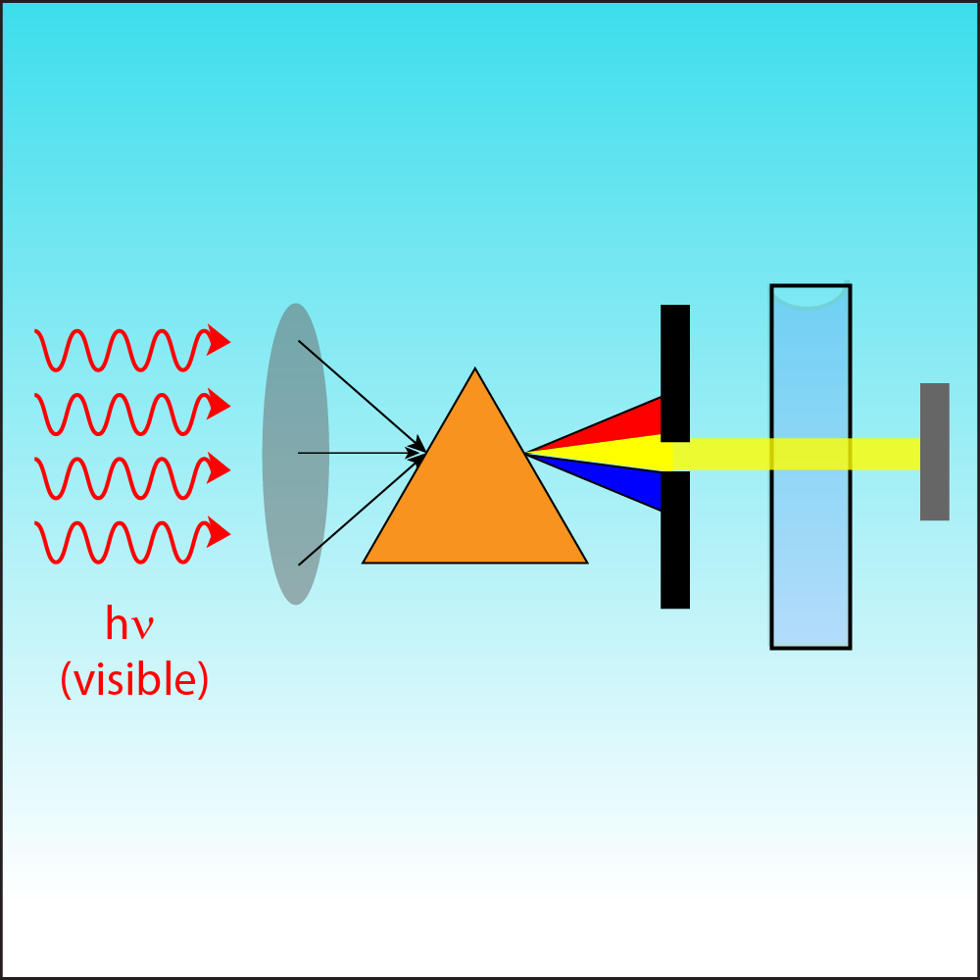
Chapter VII. Physico-chemical methods of drug quality control
Master 2: Pharmaceutical Chemistry
Module: Drug Analysis and Control
Course 01 : SPECTRAL ANALYSIS
FOR DRUG QUALITY CONTROL : Ultraviolet (UV) and visible spectrophotometry
Dr. FIZIR MERIEM

Slide 2
Ultraviolet (UV) and visible spectrophotometry
Objective:
to learn the theoretical and practical foundations of ultraviolet and visible spectroscopy; assess the quality of medicine using UV/visible spectroscopy.

Slide 3
Introduction
The spectrophotometer has well been called the workhorse of the modern laboratory. In particular, ultraviolet and visible spectrophotometry is the method of choice in most laboratories concerned with the identification and measurement of organic and inorganic compounds in a wide range of products, including, pharmaceuticals. In every branch of molecular biology, medicine and the life sciences, the spectrophotometer is an essential aid to both research and routine control.
Modern spectrophotometers are quick, accurate and reliable and make only small demands on the time and skills of the operator. However, the user who wants to optimise the functions of his instrument and to be able to monitor its performance in critical areas will need to understand the elementary physics of the absorption process as well as the basic elements of spectrophotometer design.

Slide 4
The electromagnetic spectrum.
Man lives in an environment that is permanently exposed to naturally occurring electromagnetic radiation, some of which he detects with his own senses. Radiant heat from the sun is recognised by the body as warmth while the eye responds to light to give the power of sight. But the visible spectrum, that part of the whole spread of wavelength to which the human eye is sensitive, is a very small part of the total range.
The familiar rainbow colors extend in one direction beyond red through infrared to microwaves and radio waves (increasing wavelength) and in the other direction past violet to ultraviolet and then, with progressively diminishing wavelength, via X-rays and gamma rays to cosmic rays (Fig.1).

Slide 5
Fig.1 The electromagnetic spectrum

Slide 6
The electromagnetic spectrum.
All electromagnetic radiation travels at a fixed speed of 3 × 10^10 cm per sec which is the speed of light, c, in a vacuum. The distance between two peaks along the line of travel is the wavelength, λ, and the number of peaks passing a point in unit time is the frequency, ν, usually expressed in cycles per second (hertz) (Fig.2).
The arithmetic relationship of these three quantities is expressed by: c = λ· ν.
The laws of quantum mechanics may be applied to photons to show that: E = h· ν,
where E is the energy of the radiation;
v – the frequency and his Planck's constant.
Combining these two equations: E = h · c / λ.
Fig.2 Wavelength and frequency

Slide 7
The electromagnetic spectrum.
In the visible region it is convenient to define wavelength in nanometres (nm), that is in units of 10-9 meters. The visible spectrum is usually considered to be 380–770 nm and the ultraviolet region is normally defined as 200–380 nm.

Slide 8
Specific absorption
Because each electron in a molecule has a unique ground state energy, and because the discrete levels to which it may jump are also unique, it follows that there will be a finite and predictable set of transitions possible for the electrons of a given molecule. Each of the transitions, or jumps, requires the absorption of a quantum of energy and if that energy is derived from electromagnetic radiation there will be a direct and permanent relationship between the wavelength of the radiation and the particular transition that it stimulates. That relationship is known as specific absorption and a plotof those points along the wavelength scale at which a given substance shows absorption «peaks», or maxima, is called an absorption spectrum (Fig.3).
Fig.3 Typical absorption spectrum in UV/visible region.

Slide 9
Specific absorption
The chemical group most strongly influencing molecular absorption characteristics is called a chromophore. Chromophores which can be detected by UV/Vis spectrophotometers always involve a multiple bond (such as C = C, C = O or C ≡N) and may be conjugated with other groups to form complex chromophores.
A typical example is the benzene ring which has an absorption peak at 254 nm. Increasingly complex chromophores move the associated absorption peak towards longer wavelengths and generally increase the absorption at the maxima.

Slide 10
Absorption and concentration.
Fig. 5 shows the absorption of radiation by a solution containing absorbing compound.
Fig.5 Absorption of light by a solution
For analytical purposes, two main propositions define the laws of light absorption.
Lambert's Law. The proportion of incident light absorbed by a transparent medium is independent of the intensity of the light (provided that there is no other physical or chemical change to the medium). Therefore successive layers of equal thickness will transmit an equal proportion of the incident energy. Lambert's law is expressed by : I/I0 = T,
where I is the intensity of the transmitted light;
I0– the intensity of the incident light;
T– the Transmittance.

Slide 11
Absorption and concentration.
2. Beer's Law.
The absorption of light is directly proportional to both the concentration of the absorbing medium and the thickness of the medium in the light path.
A combination of the two laws (known jointly as the Beer Lambert Law) defines the relationship between absorbance (A) and transmittance (T):
A= logI0/I= log 1/T= - logT= ε· C· l,
where
A is absorbance (no unit of measurement);
ε– molar absorptivity (dm3mol-1cm-1);
C– molar concentration (mol dm-3);
l – path length (cm).

Slide 12
Instrumentation.
The minimum requirements of an instrument to study absorption spectra (a spectrophotometer) are shown below (Fig. 6) and include:
1) a source of radiation of appropriate wavelengths;
2) a means of isolating light of a single wavelength and getting it to the sample compartment – monochromator and optical geometry;
3) a means of introducing the test sample into the light beam – sample handling;
4) a means of detecting and measuring the light intensity.
Fig.6 Basic construction of a spectrophotometer

Slide 13
Instrumentation.
Sources:
The ideal light source would yield a constant intensity over all wavelengths with low noise and long-term stability. Unfortunately, however, such a source does not exist. Two sources are commonly used in UV-visible spectrophotometers
The first source, the deuterium arc lamp, yields a good intensity continuum in the UV region and provides useful intensity in the visible region (see Fig.7). Although modern deuterium arc lamps have low noise, noise from the lamp is often the limiting factor in overall instrument noise performance. Over time, the intensity of light from a deuterium arc lamp decreases steadily. Such a lamp typically has a half-life (the time required for the intensity to fall to half of its initial value) of approximately 1,000 h.
Fig.7 Intensity spectrum of the deuterium arc lamp

Slide 14
Instrumentation.
Sources:
The second source, the tungsten-halogen lamp (see Fig.8), yields good intensity over part of the UV spectrum and over the entire visible range. This type of lamp has very low noise and low drift and typically has a useful life of 10,000 h. Most spectrophotometers used to measure the UV-visible range contain both types of lamps. In such instruments, either a source selector is used to switch between the lamps as appropriate, or the light from the two sources is mixed to yield a single broadband source.
Fig.8 Intensity spectrum of the tungsten-halogen lamp

Slide 15
Instrumentation.
Sources:
An alternate light source is the xenon lamp (see Fig.9), which yields a good continuum over the entire UV and visible regions. However, because the noise from currently available xenon lamps is significantly worse than that from deuterium or tungsten lamps, xenon lamps are used only for applications such as diffuse reflectance measurements, in which high intensity is the primary concern.
Fig.9 Intensity spectrum of the xenon lamp

Slide 16
Instrumentation.
Sources:
Ultraviolet light is generally derived from a deuterium arc that provides emission of high intensity and adequate continuity in the 190–380 nm range.
Visible light is normally supplied by a tungsten lamp or, in modern systems, by a tungsten-halogen.

Slide 17
Instrumentation.
Dispersion devices
Dispersion devices cause different wavelengths of light to be dispersed at different angles. When combined with an appropriate exit slit, these devices can be used to select a particular wavelength (or, more precisely, a narrow waveband) of light from a continuous source. Two types of dispersion devices, prisms and holographic gratings, are commonly used in UV-visible spectrophotometers.
A prism generates a rainbow from sunlight. This same principle is used in spectrophotometers. Prisms are simple and inexpensive, but the resulting dispersion is angularly nonlinear (see Fig.10 a). Moreover, the angle of dispersion is temperature sensitive.

Slide 18
Instrumentation.
Dispersion devices
Fig.11 Dispersion devices

Slide 19
Instrumentation.
Dispersion devices
For these reasons, most modern spectrophotometers contain holographic gratings instead of prisms. These devices are made from glass blanks, onto which very narrow grooves are ruled. Traditionally, this task was done mechanically, but modern production methods use a holographic optical process. The dimensions of the grooves are of the same order as the wavelength of light to be dispersed. Finally, an aluminum coating is applied to create a reflecting source. Light falling on the grating is reflected at different angles, depending on the wavelength. Holographic gratings yield a linear angular dispersion with wavelength and are temperature insensitive. However, they reflect light in different orders, which overlap (see Fig.10b). As a result, filters must be used to ensure that only the light from the desired reflection order reaches the detector. A concave grating disperses and focuses light simultaneously.

Slide 20
Instrumentation.
Dispersion devices
A monochromator consists of an entrance slit, a dispersion device, and an exit slit. Ideally, the output from a monochromator is monochromatic light. In practice, however, the output is always a band, optimally symmetrical in shape. The width of the band at half its height is the instrumental bandwidth (IBW).

Slide 21
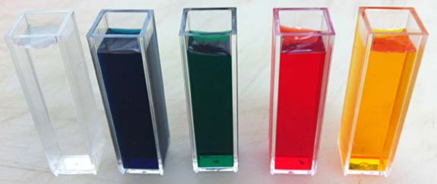
Instrumentation.
Sample handling
Cuvettes are typically made of glass or UV grade silica (according to the wavelength range of interest).
The holder that locates the cuvette in the light beam must ensure precise and reproducible location with respect to the beam.
The most commonly used cuvette has a light path length of 10 mm,
Fig.11 Sample cuvettes

Slide 22
Instrumentation.
Detectors
A detector converts a light signal into an electrical signal. Ideally, it should give a linear response over a wide range with low noise and high sensitivity. Spectrophotometers normally contain either a photomultiplier tube detector or a photodiode detector.

Slide 23
Instrumentation.
Measuring Systems.
The primary function of a spectrophotometer ends with the provision of a signal (normally an electrical voltage) that is proportional to the absorption by a sample at a given wavelength. The signal handling and measuring systems can be as simple as an amplifier and a meter or as elaborate as a personal computer and printer, depending on the application.

